Slide 1
Social Media Strategy
Aakash Sathish, Gurlal Dhaliwal, Kirk Nii Laryea, Nicolette Hood, & Sarah Peng

Slide 2
Team, Goals & Objectives
Data-driven content
Increasing media engagement
Enhancing communication
Aligning outreach with client goals
Our main goal is to create a tailored social media approach that aligns with the client’s calendar of events that includes:
Content recommendations customized for each audience and platforms like Facebook, Instagram and Twitter
Posting guidelines to ensure optimal timing and frequency.
Best practices for increasing audience growth and engagement.

Slide 3
Client Background
Promoting UMD’s iConsutlancy through student-driven social storytelling
Students
Platform Expansion
Show off their projects
Pick new platforms to showcase the iConsultancy
What is information science?
Clients
Show off the current clients the iConsultancy works with.
Create another connection to the iSchool

Slide 4

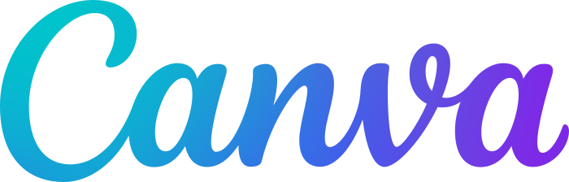


Approach
Tools
Research
Conducted research by analyzing social media accounts and strategies used by other similar iConsultancy organizations and brands. This helped us identify trends to post, and common mistakes to avoid.
We then turned to tools to support our workflow and content development, such as Canva to design visually engaging post templates, we also used Google Sheets to build and maintain a collaborative content posting calendar, And lastly we utilized Jira alot to assign and track tasks across our team.

Slide 5
Findings and Outcomes
Social Media Calendar
Social Media Post Templates
Two month content calendar.
Posting schedule aligned with peak engagement times.
Designed for long-term brand awareness.
Ensures consistency and predictability in digital presence.
Designed for long-term brand awareness.
Canva-based, reusable designs for efficiency
Formats include FAQs, client spotlights, and student features
Simple to customize, no design experience needed

Slide 6
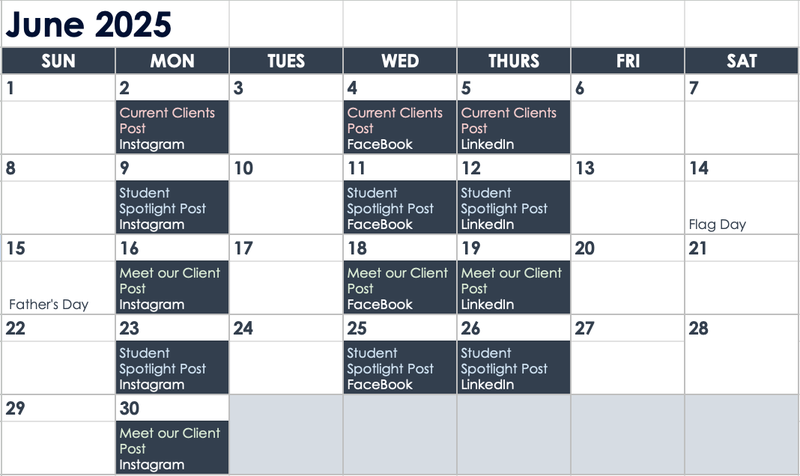
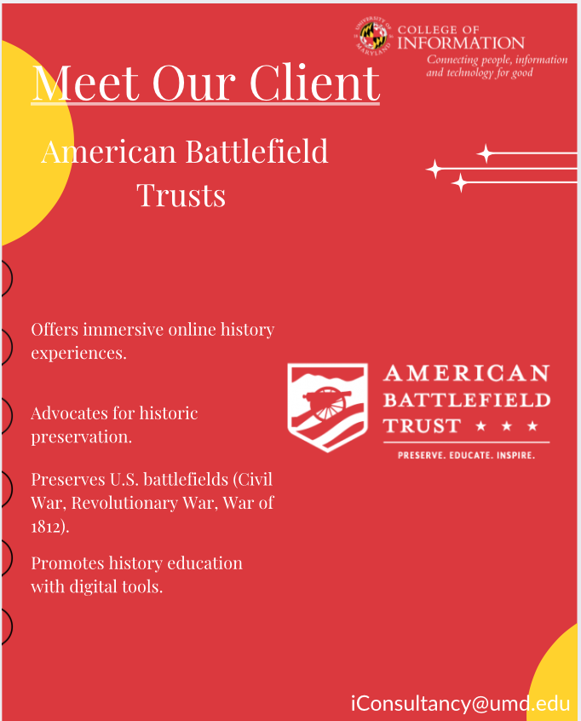
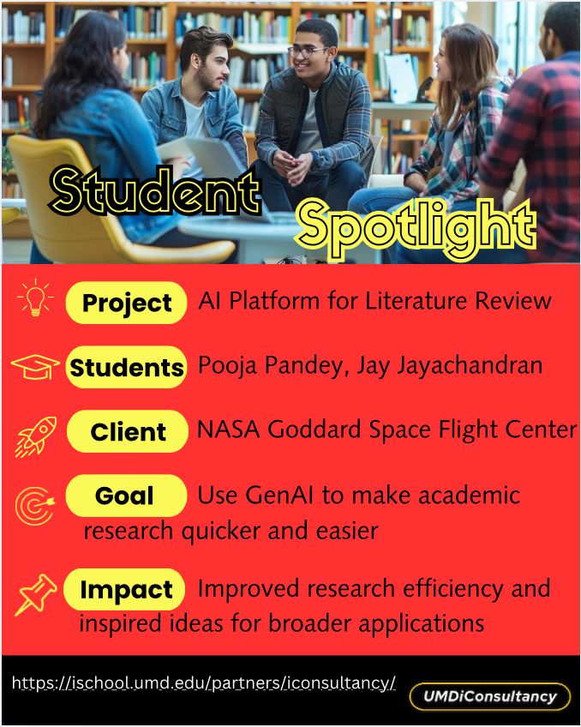
Primary Deliverables
Social Media Calendar
Client Post
Student Post

Slide 7






Impact
Reusable Templates
Saves Time
Helps maintain consistent visuals and messaging across posts
No need to start from scratch, just plug in new content
Content Calendar
Builds Visibility
Two-month posting schedule tailored to each platform’s best days and times
Promotes the work iConsultancy does for both students and clients
Flexible System
Supports Growth
Easy for Justin or future student teams to update and manage
Strategy is adaptable and designed to evolve with the program
Notes:
The impact of our project is really centered around creating a system that’s easy to use, sustainable, and aligned with what iConsultancy wants to communicate. By designing reusable template posts and building a two-month content calendar, we gave Justin a complete strategy that can be picked up and used immediately—without needing to start from scratch or hire outside help. Everything we created is flexible. The templates allow Justin or future student teams to feature different clients, projects, or stories while keeping a consistent tone and visual style. Since the calendar is tailored around the best days and times to post, each piece of content has the best chance to reach the right audience—whether that’s prospective students or future clients. This strategy not only brings visibility to the amazing work being done through iConsultancy, but also sets up a foundation that can grow with the program over time.

Slide 8
Reflection and Next Steps
Initial Plans
End Result
We had rushed into making prototype posts which ended up wasting time in the future.
Although there were many roadblocks along the way, our final deliverables would have been nearly the same regardless of how we approached this.
Client Communication
Future
Asking more specific questions to the client to better understand their wants and needs was very beneficial.
Increasing the frequency of posts, expanding to different kinds of posts, such as reels and shorts, will allow for better engagement and retention rates.

Slide 9
Thank you!
Any Questions?

